Slide 1

Flight Price Prediction

Slide 2
Contents:
Introduction
Problem Statement
Understanding of Dataset
Tools Used

Slide 3
Contents:
Data Pre-Processing
Data Visualization
Model Building
Saving Best Model

Slide 4
Introduction

Slide 5
Introduction
Flight Prices are very dynamic in nature and depend on a numerous factors, based on which the prices are decided. In this project, we'd try to solve this problem by understanding the factors responsible, understand the patterns for the dynamism in the prices and build a Machine Learning Model that is able to utilize these features, data patterns to predict the prices as accurately as possible.

Slide 6
Problem Statement

Slide 7
Problem Statement
Anyone who has booked a flight ticket knows how unexpectedly the prices vary. The cheapest available ticket on a given flight gets more and less expensive over time. This usually happens as an attempt to maximize revenue based on -
Time of purchase patterns (making sure last-minute purchases are expensive)
Keeping the flight as full as they want it (raising prices on a flight which is filling up in order to reduce sales and hold back inventory for those expensive last-minute expensive purchases)
To solve this problem, we have :
Scrapped the data for 60 days.
Which include 4 cities.
Bengaluru
Chennai
Mumbai
Delhi
The dataset contains about 1,37,000 rows.
Using the dataset, we'd aim to build a machine learning model that predicts the prices for the flights.

Slide 8
Understanding Data

Slide 9
Understanding of Dataset
Data contains 1,37,107 entries each having 14 variables.
Data does not contain any Null values.
Extensive EDA has to be performed to gain relationships of important variable and price.
Data contains all the features as categorical in nature and Target as Continuous.
There are no duplicate values in the dataset.
There are certain outliers present in the dataset which would need to be handled.

Slide 10
Tools Used

Slide 11
Tools Used
Python(Jupyter)
NumPy
Pandas
Sklearn
Matplotlib
Seaborn
Plotly
Regression Models
Ensembling Technique
GridSearch CV(Hyperparameter Tuning)

Slide 12
Pre-Processing

Slide 13
Pre-Processing
Loading the Dataset.
Checking Null Values and basic info.
Feature Engineering
Encoding
Checking Correlations
Removing Outliers
Splitting the Data Frame into Features and Target
Scaling the Model

Slide 14
Data Visualization

Slide 15
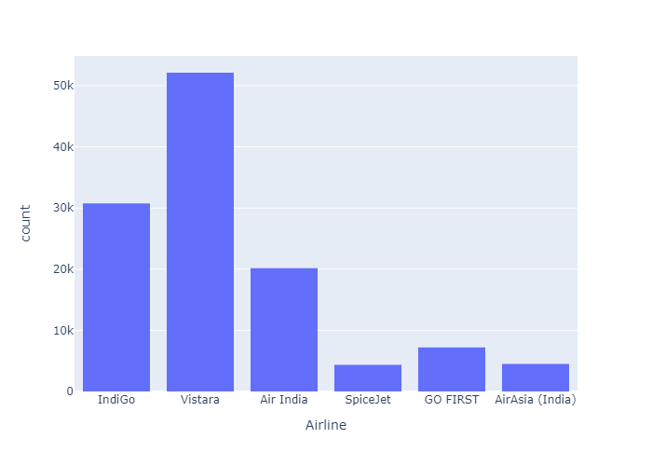
Airline :
We see that Vistara is the most preferred airlines and Spice Jet the least.

Slide 16
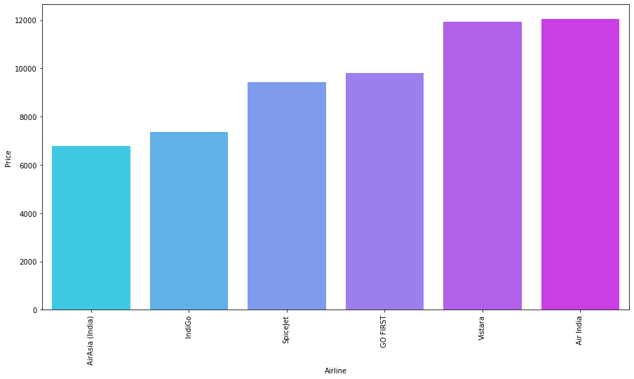
Airline Vs Price :
We also see that AirAsia(India)is the cheapest when it comes to price and Air India is the most Expensive.

Slide 17
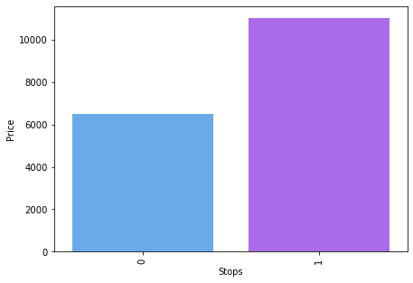
Number of Stops Vs Price :
We see that Non-Stop flights are cheaper than flights with a stop.

Slide 18
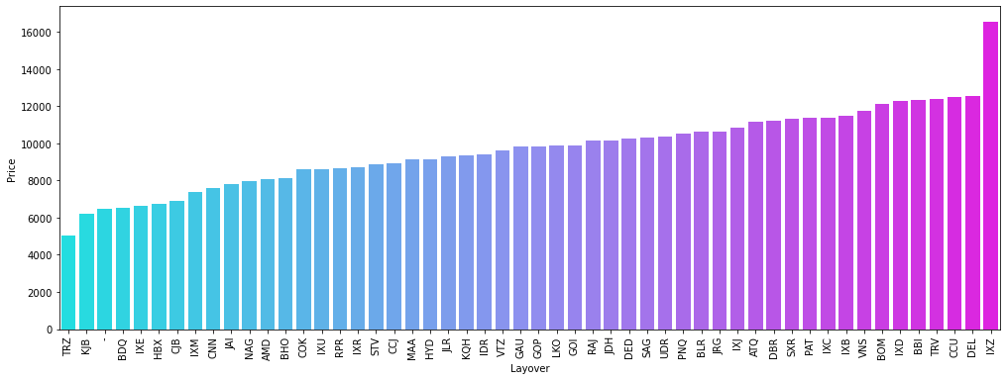
Layover Vs Price :
We see flights with layover at TRZ and KJB are the cheapest followed by non-stop flights.

Slide 19
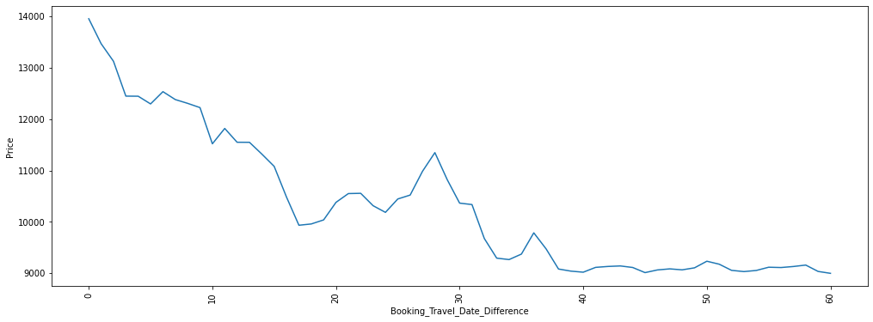
Days to Travel Vs Price :
We see that as the Booking Date vs Travel Date Difference increases, the prices decrease

Slide 20
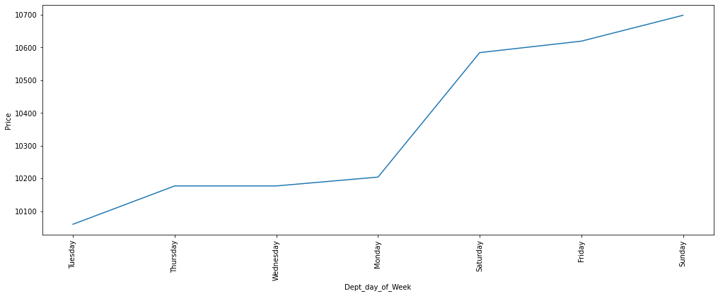
Day of the Week Vs Price :
We see the flight prices are the cheapest during midweek and the most expensive on weekends

Slide 21
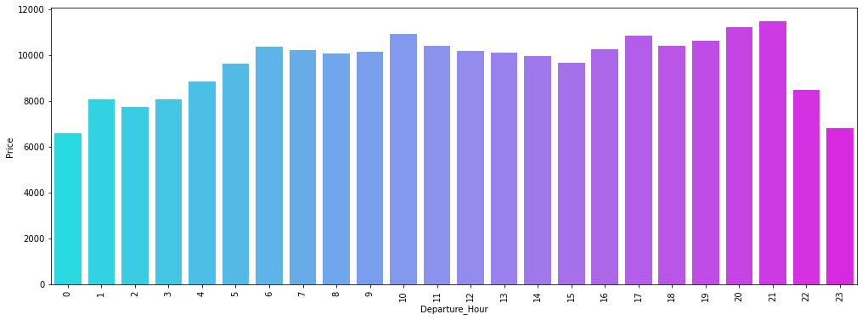
Departure Time Vs Price :
We see that the flight prices are generally higher for the flights between 11pm to 4 am, this may be due to majority of international flights operating at night

Slide 22
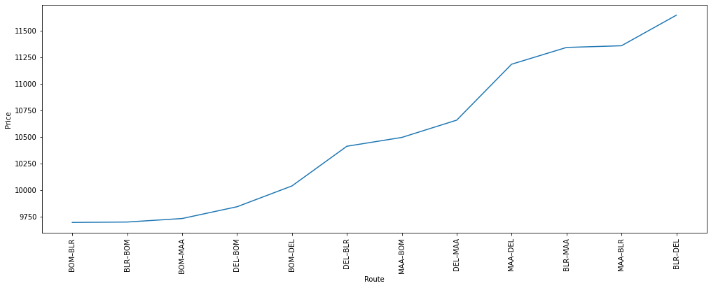
Route Vs Price :
We see that flights operating on Mumbai- Bangalore route are the cheapest and Bangalore-Delhi the most expensive.

Slide 23
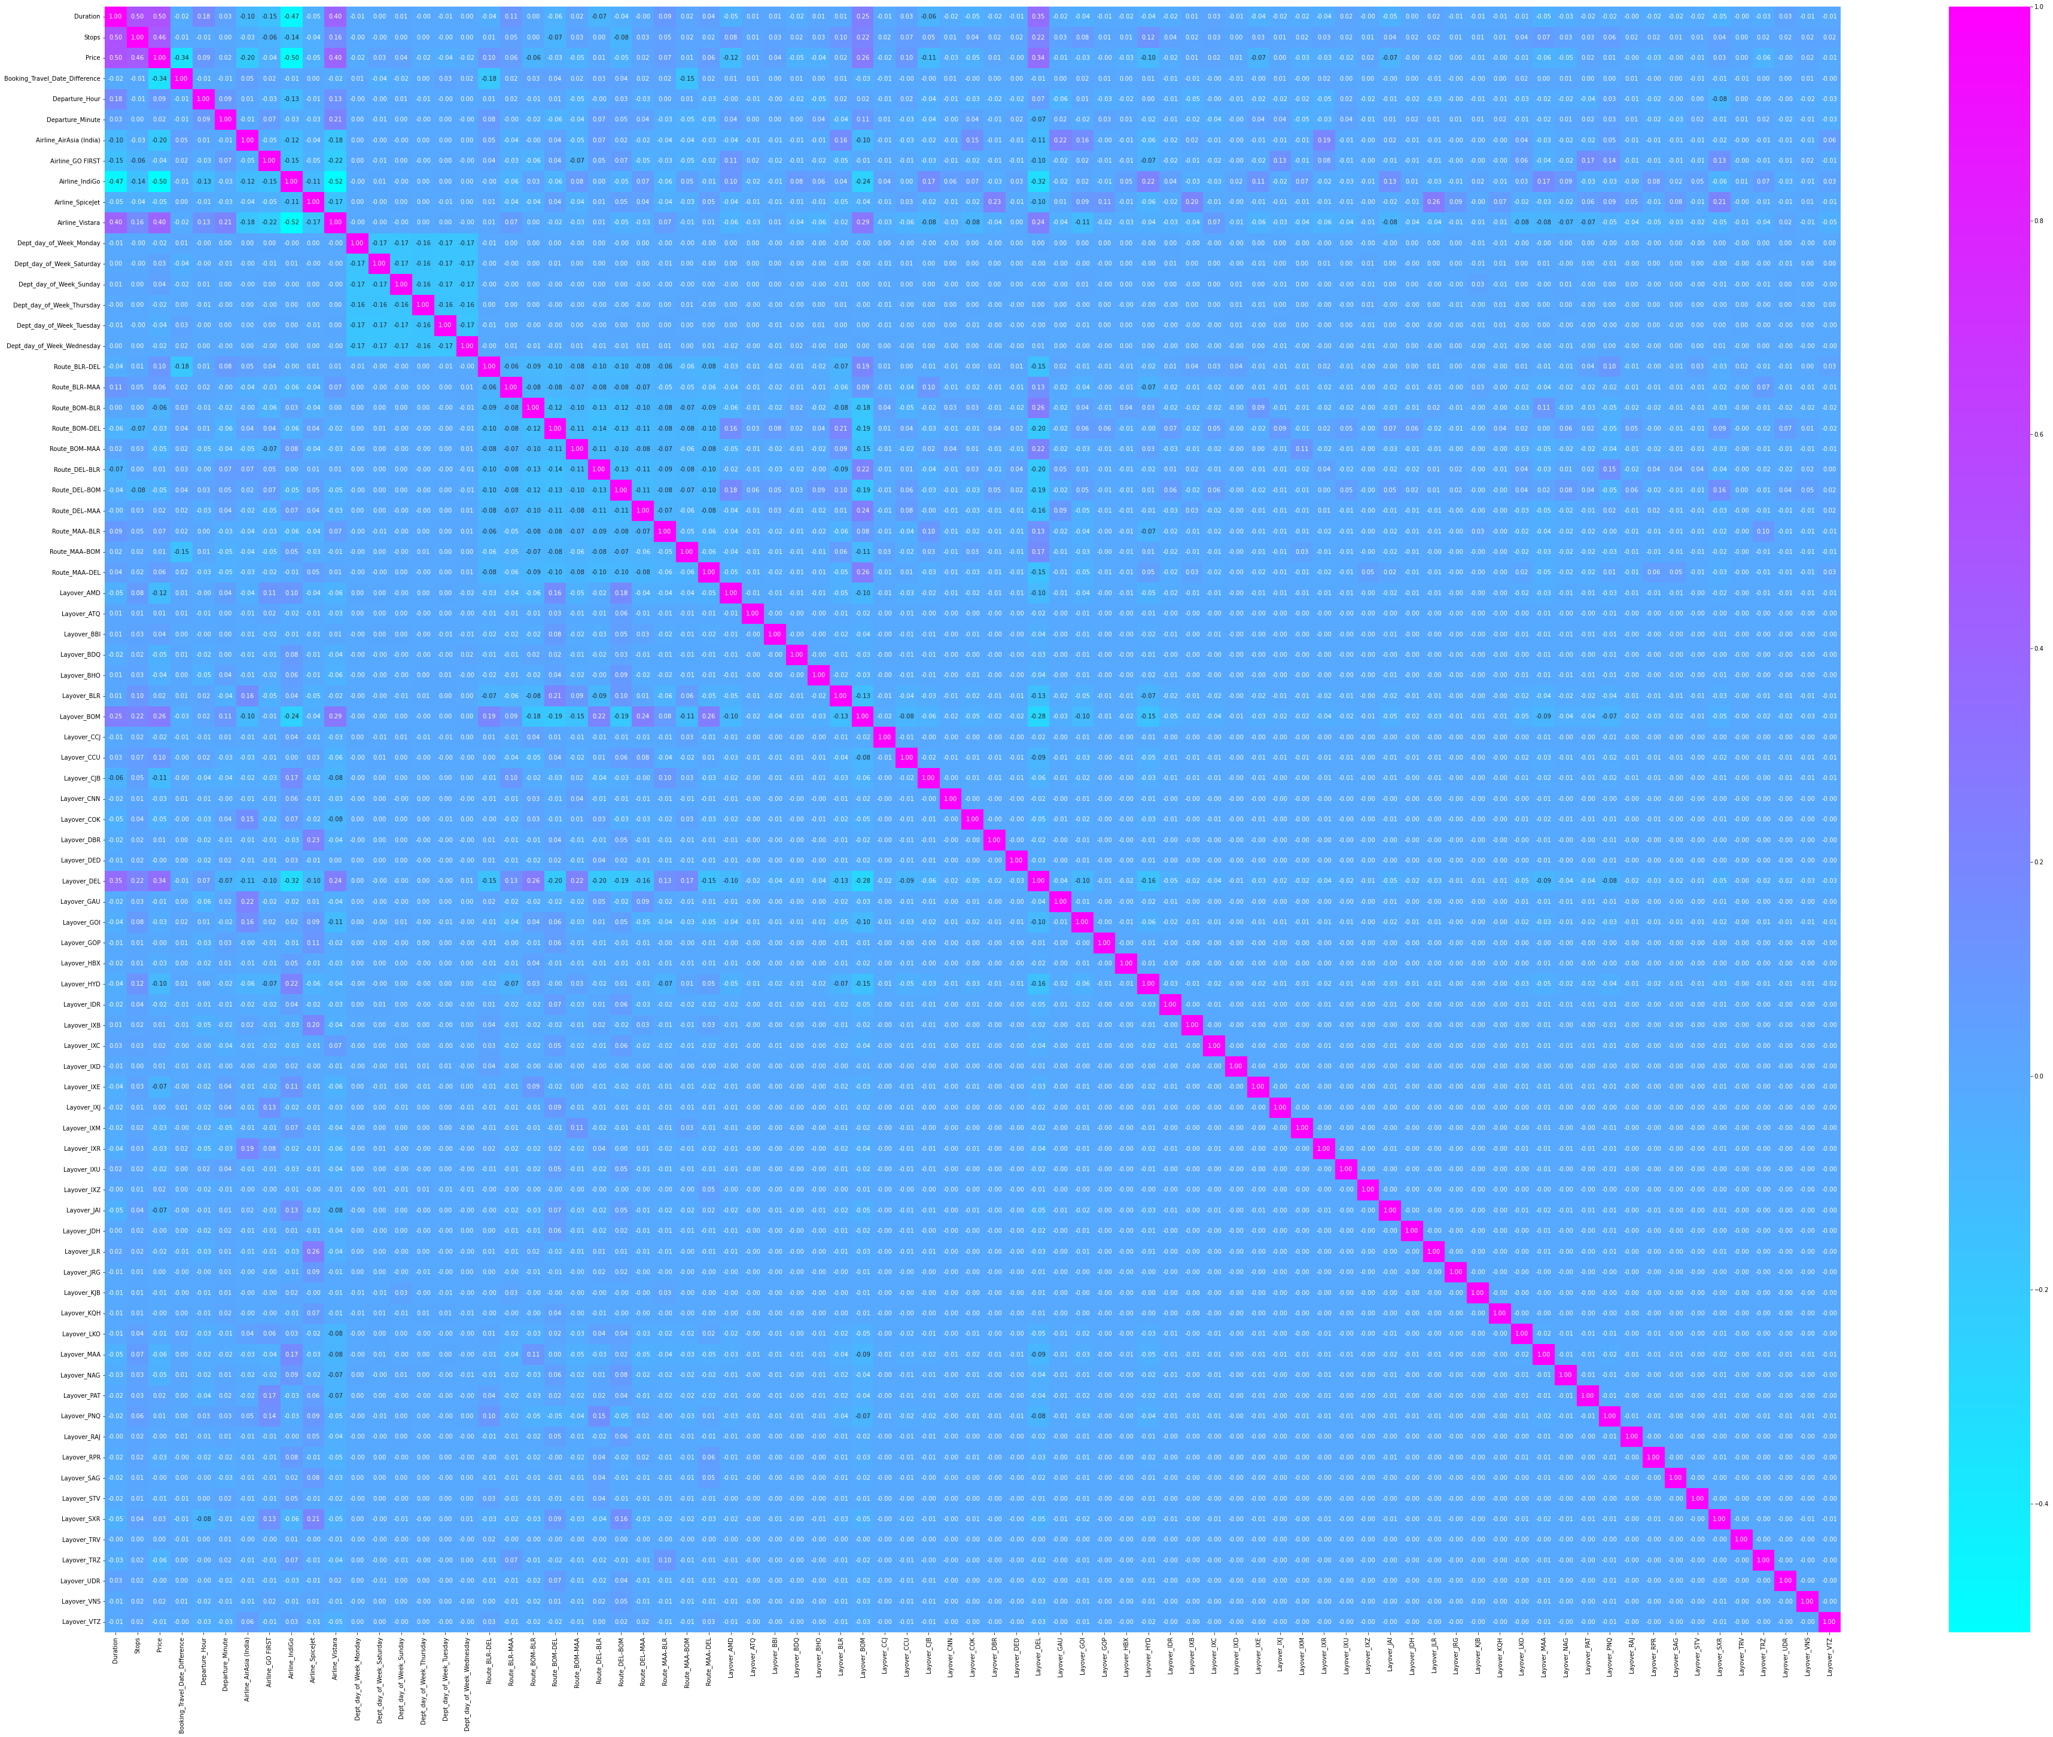
Correlations
We see that the features are both positively and negatively correlated with the Target Variable.
- Duration has the Highest Positive Correlation.
- Airline_Indigo Highest Negative Correlation

Slide 24
Model Building

Slide 25
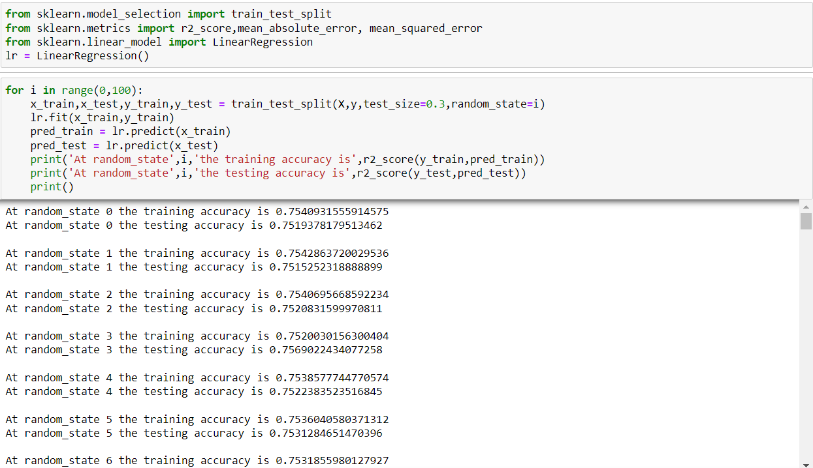
Model Building
Importing necessary libraries
Finding the best random state

Slide 26
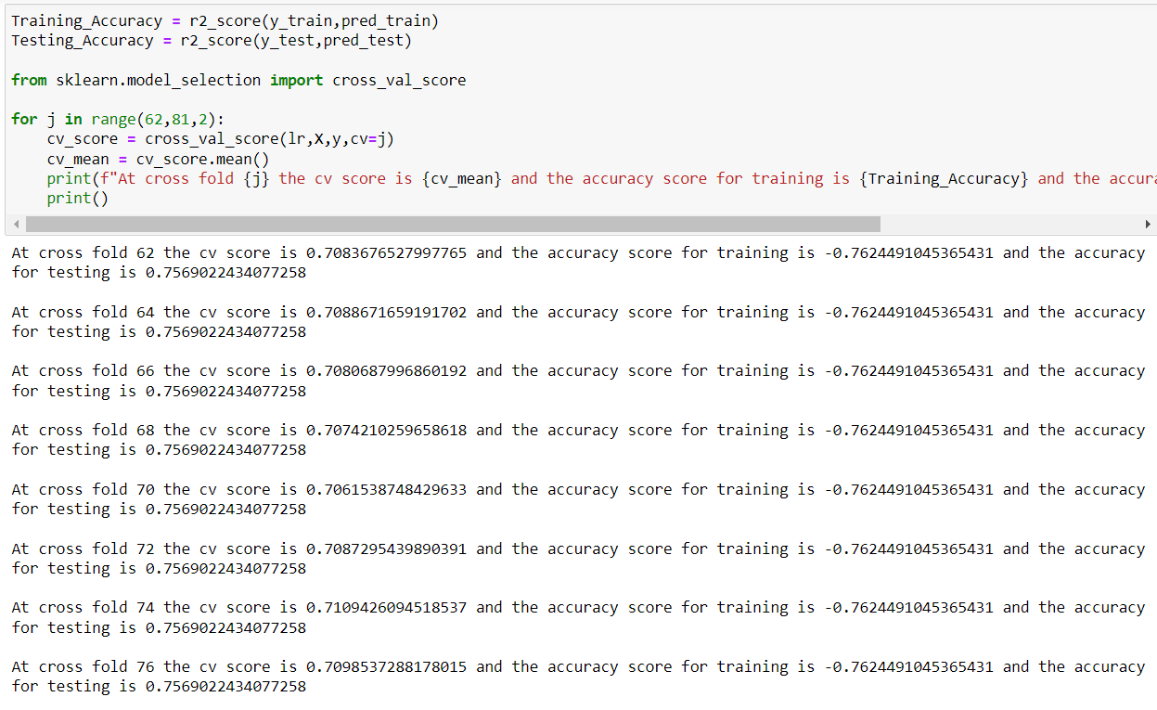
Model Building
Finding best k-folds for cross-validation

Slide 27
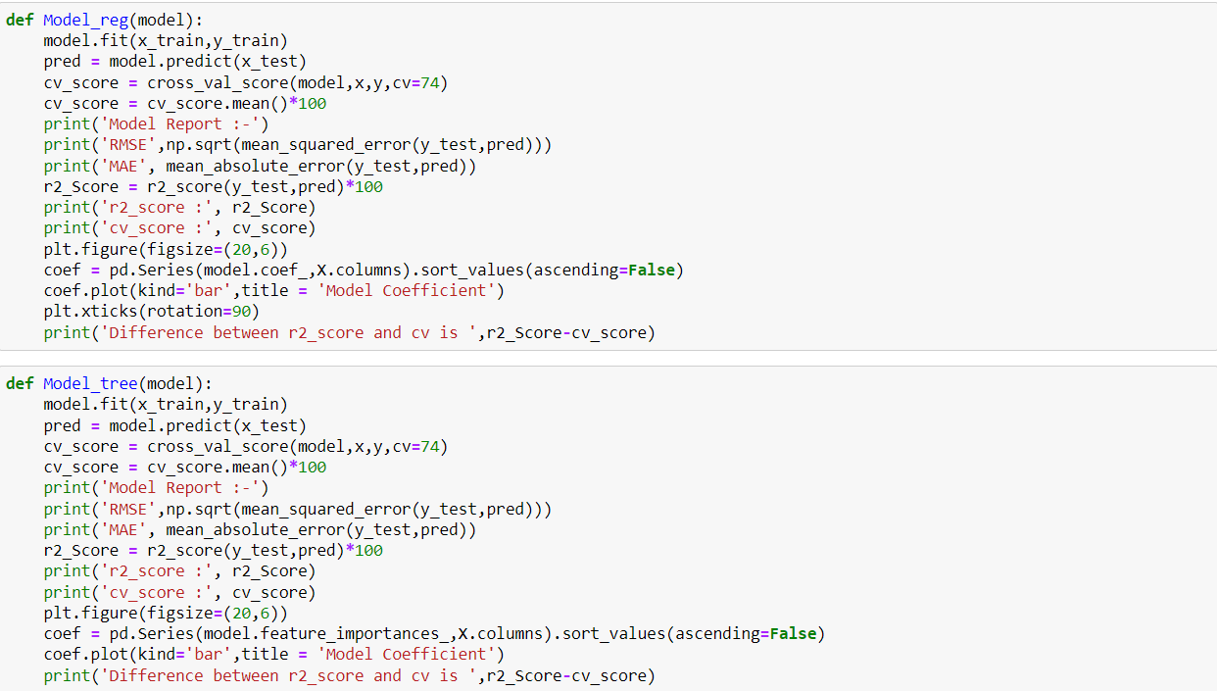
Defining the Models for analysis
Defining Linear Models and Tree based Models.

Slide 28
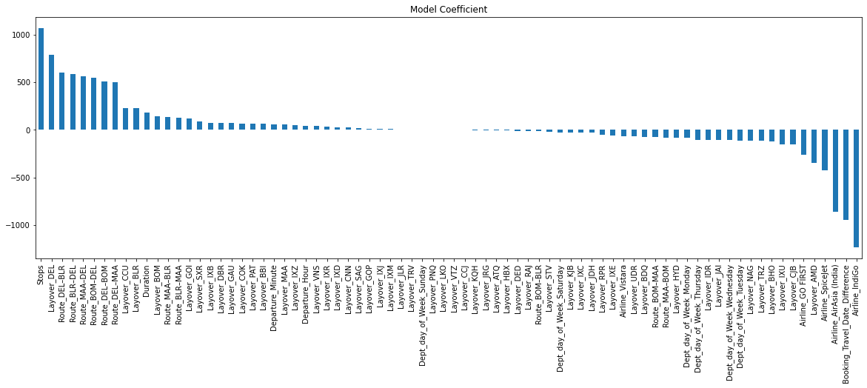
LinearRegression
Model Report :-
RMSE 1562.6182617913107
MAE 1168.658573661111
r2_score : 75.2083159997081
cv_score : 71.09036296045844
Difference between r2_score and cv is 4.11795303924967

Slide 29

Ridge Regression
Model Report :-
RMSE 1562.6180240429671
MAE 1168.6575511480285
r2_score : 75.20832354368926
cv_score : 71.09222060696257
Difference between r2_score and cv is 4.116102936726691

Slide 30
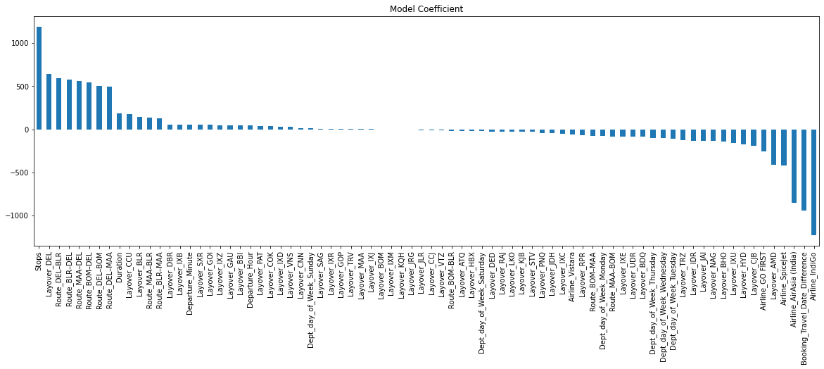
Lasso Regression
Model Report :-
RMSE 1562.5442949862686
MAE 1168.4617781840836
r2_score : 75.21066298143901
cv_score : 71.03223459012486
Difference between r2_score and cv is 4.178428391314156

Slide 31
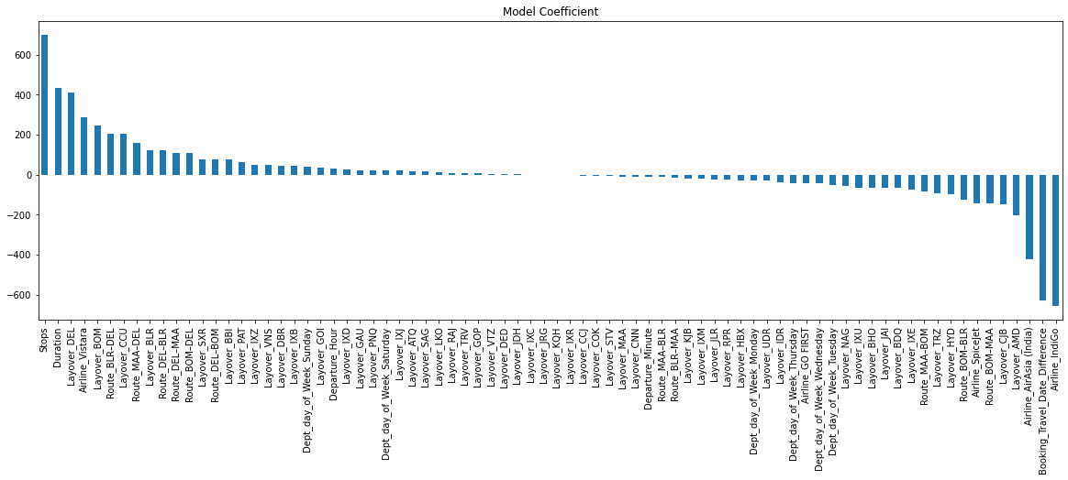
ElasticNet Regression
Model Report :-
RMSE 1766.8069273121673
MAE 1316.3860752963592
r2_score : 68.30590002618014
cv_score : 43.96825407606805
Difference between r2_score and cv is 24.33764595011209

Slide 32
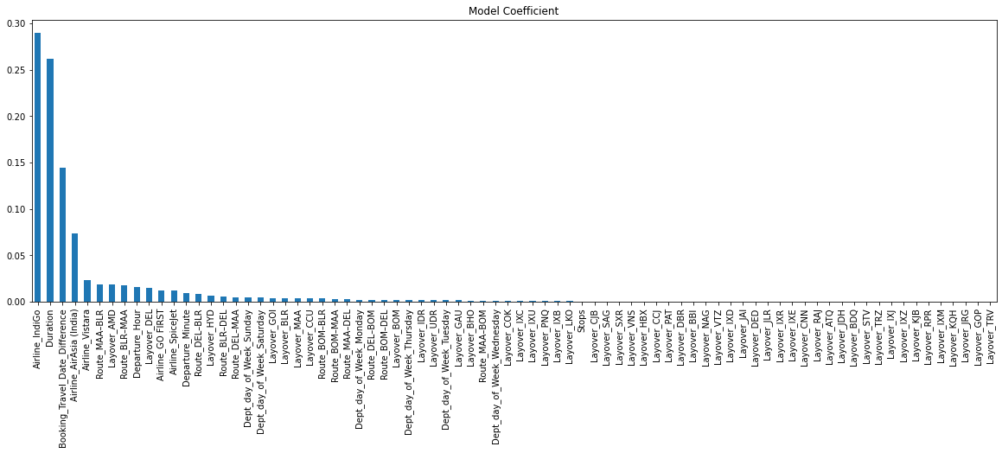
DecisionTreeRegressor
Model Report :-
RMSE 938.7551847579989
MAE 304.7207956189882
r2_score : 91.05243351678327
cv_score : 75.02564835648053
Difference between r2_score and cv is 16.026785160302737

Slide 33

RandomForestRegressor
Model Report :-
RMSE 725.749817272789
MAE 300.37923105297506
r2_score : 94.65221292745726
cv_score : 83.72409435719314
Difference between r2_score and cv is 10.928118570264118

Slide 34
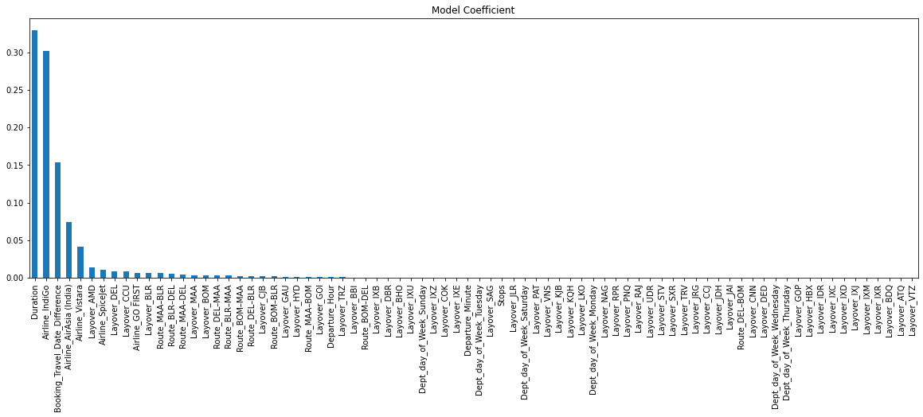
GradientBoostingRegressor
Model Report :-
RMSE 1320.108826147913
MAE 888.1811026437481
r2_score : 82.30625735401263
cv_score : 79.56942246209962
Difference between r2_score and cv is 2.7368348919130057

Slide 35
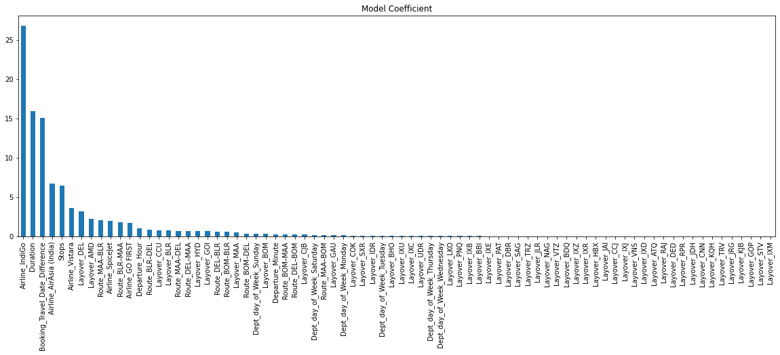
CatBoostRegressor
Model Report :-
RMSE 853.1778822474614
MAE 501.0997259385046
r2_score : 92.6094048389248
cv_score : 89.27207672317789
Difference between r2_score and cv is 3.3373281157469137

Slide 36
Hyper-Parameter Tuning

Slide 37
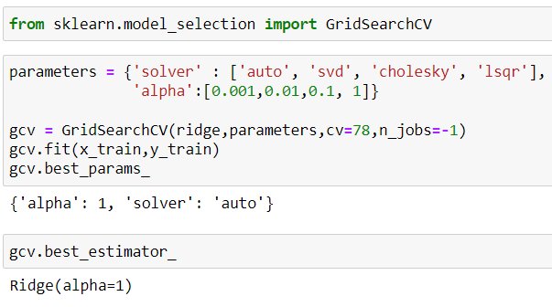
Ridge
Model Report :-
RMSE 1562.6180240429671
MAE 1168.6575511480285
r2_score : 75.20832354368926
cv_score : 71.09222060696257
Difference between r2_score and cv is 4.116102936726691

Slide 38
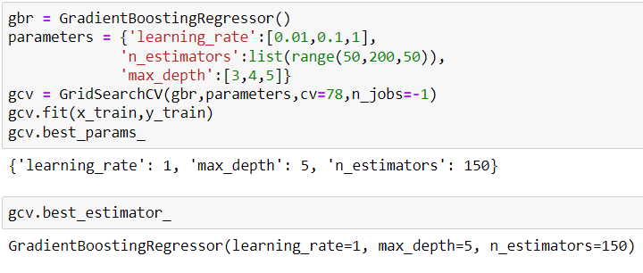
GradientBoostingRegressor
Model Report :-
RMSE 888.4303640042212
MAE 511.60395283034126
r2_score : 91.98604272214111
cv_score : 83.50855063198142
Difference between r2_score and cv is 8.477492090159686

Slide 39
Final Model

Slide 40

GradientBoostingRegressor without HyperParameter Tuning
Model Report :-
RMSE 1320.1088261479124
MAE 888.1811026437477
r2_score : 82.30625735401264
cv_score : 79.47464674222854
Difference between r2_score and cv is 2.8316106117841002

Slide 41
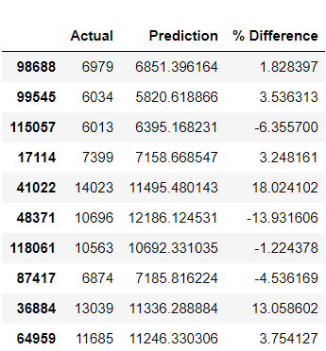
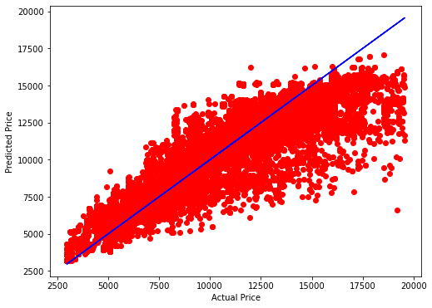
Actual Value vs Predicted Value Comparison and Plot

Slide 42
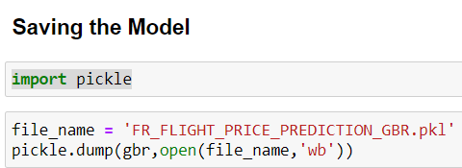
Saving The Best Model

